Slide 1
ICS CHAT SYSTEM GUI
BY ROBIN AND PAULE

Slide 2
MAJOR IMPROVEMENTS
No need to use terminal to chat
A sleek and simple design for an enhanced chatting experience
Separate interfaces for Log In and Chatting

Slide 3
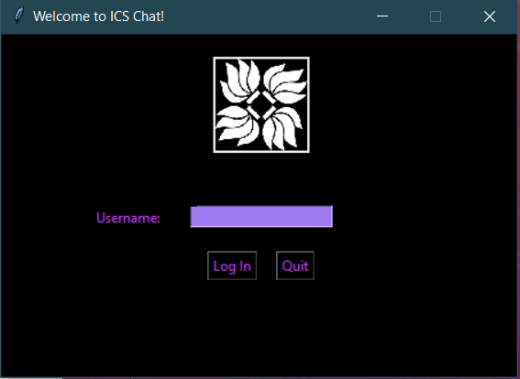
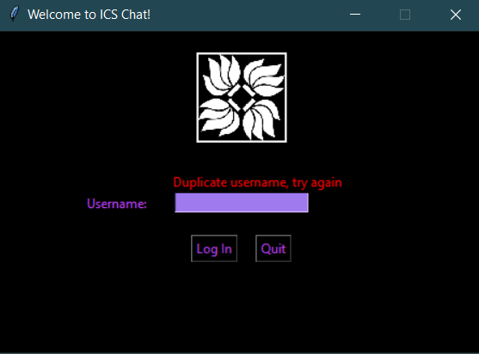
LOG IN
Username entry field
If the username is already in use or too short shows an error
If the username is ok, opens chatting window
Log In button – proceed
Quit button – quit and close the interface

Slide 4
CHATTING
Takes everything entered in the console originally into GUI
Send button – send the text/command
Quit button – exit the chat system and close the window
Scrollbar

Slide 5

DEMO
Link

Slide 6
Q&A
Thank you for listening!

